Slide 1

Predicting Poultry Mortality Using Environmental and Health Indicators
Group Members:
1. Shiva Giri
2. Sunil Gautam
3. Rohan Chhetry
4. Shabdha manandhar

Slide 2
The Problem
Poultry farming is a critical part of food security and the economy, but disease outbreaks can cause significant losses — especially when birds die unexpectedly.
Goal -
Our goal was to predict bird mortality — specifically the 'Found dead' cases — using symptoms and environmental data.
Early prediction means early intervention, saving both lives and resources.

Slide 3
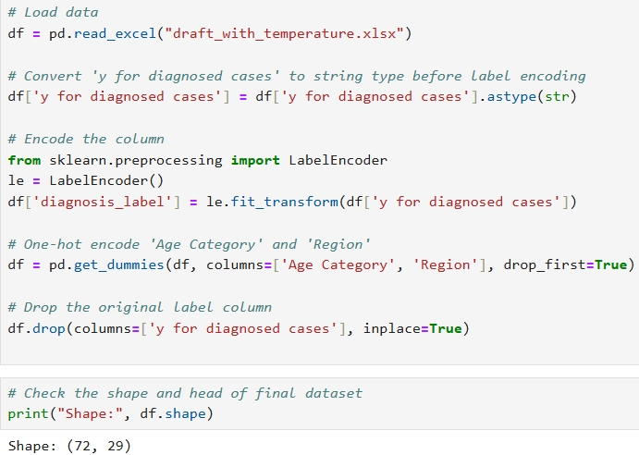
The Data
Our dataset included two key types of information:
Health Indicators – like Wasting, Respiratory symptoms, Diarrhoea, and Skin conditions
Environmental Data – specifically Avg Min and Max Temperatures
By combining these, we created a heterogeneous dataset, allowing us to study the relationship between environmental stress and poultry health.

Slide 4
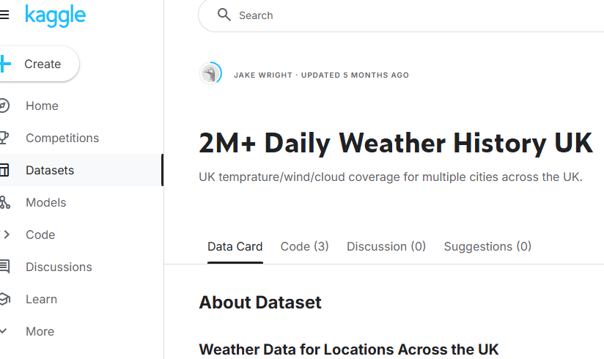
The UK Regional Weather Dataset
The Dataset is formally a Kaggle dataset. It has other aspects like rain, humidity, wind speed, we utilised only the max and min temperature in our analysis.
The various locations in dataset was mapped to the regions of our avian dataset and average was used to calculate the region temperature.

Slide 5
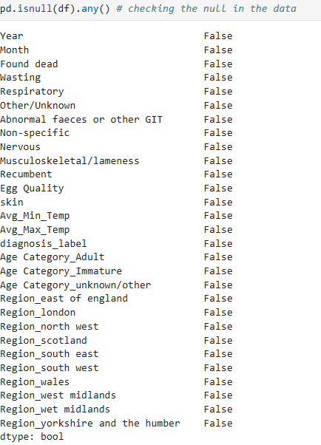
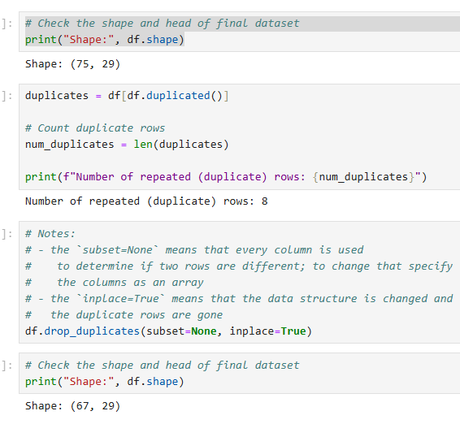
Cleaning data
Found no missing data.
Checked for duplicate values and found 8 duplicates, which were removed from the dataset to improve accuracy.

Slide 6
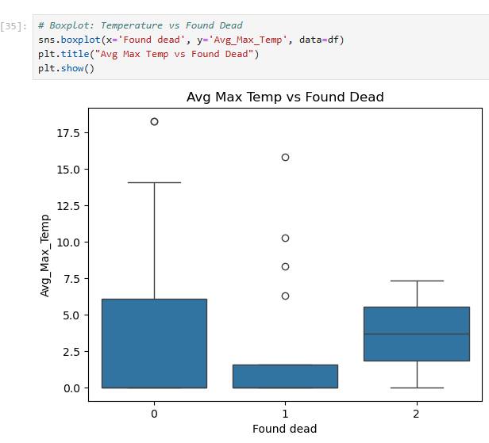
Exploratory Data Analysis (EDA)
We started with EDA to explore relationships in the data.
Our correlation heatmap showed that Avg Max Temp was positively correlated with 'Found dead'.
Boxplots revealed that mortality increased in higher temperature ranges.
Pairplots highlighted other symptoms like Wasting and Respiratory issues as potential predictors.

Slide 7
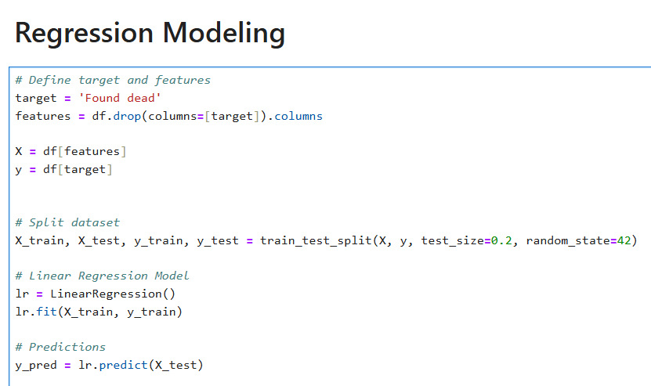
Model Selection – Linear Regression
We chose Linear Regression because:
Our target variable 'Found dead' is continuous
Linear regression is interpretable and effective for understanding variable importance
We trained the model using features like symptoms, diagnosis label, region, and environmental temperature

Slide 8
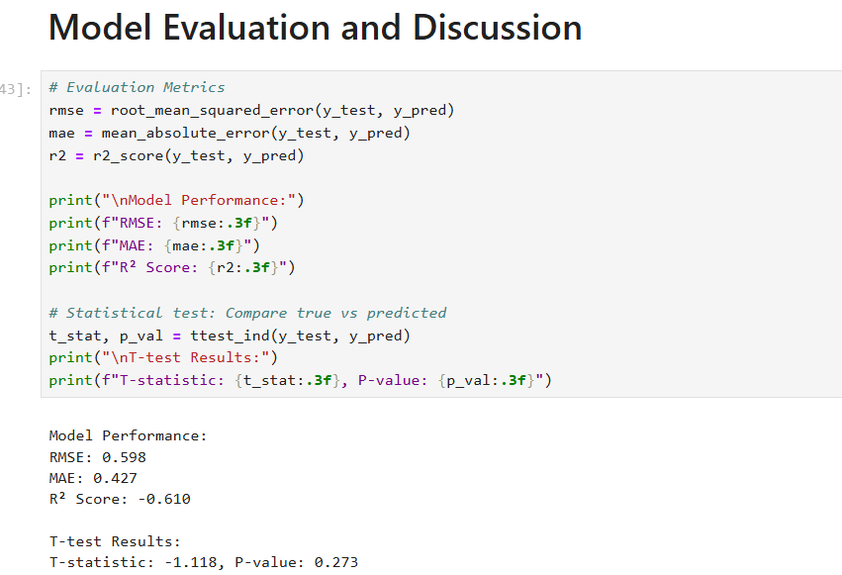
Model Evaluation
We evaluated the model using:
RMSE (Root Mean Squared Error): Shows how far our predictions are from actual values
R² Score: Shows how much variance in death cases our model can explain
We also ran a t-test to check the statistical significance of the predictions, and our model performed well.

Slide 9
Key Insights
1. Regions with higher max temperatures showed more deaths 2. Symptoms like Wasting and Respiratory problems were strong indicators 3. Predictive modeling can help target early interventions and improve poultry health
outcomes
Better temperature control and health monitoring could reduce unexpected poultry mortality.

Slide 10
Final Thoughts
This project shows the power of combining health and environmental data to solve real-world problems.
Our model could be the first step in building a decision-support tool for poultry farm managers and veterinarians.

Slide 11
Thank You
Thanks for your attention. We’re happy to take any questions.

